Slide 1



Call for proposal – HUSK-2401
Public consultation
Interreg Hungary – Slovakia programme
Close-ended, targeted, competitive call
#interreghusk

Slide 2

„The real voyage of discovery consists
not in seeking new landscapes,
but in having new eyes.”
Marcel Proust
Notes:
A felfedezés igazi varázsa nem abból áll, hogy új helyeket ismerjünk meg, hanem hogy más szemmel nézzünk. Marcel Proust

Slide 3

Mission
Action 2.4.2 aims to improve the overall sustainability and competitiveness of tourism destinations in the programme area by providing integrated and harmonised tourism offers across the border.
Notes:
A 2.4.2. intézkedés célja a programterületen található turisztikai desztinációk fenntarthatóságának és versenyképességének javítása a határon átnyúló integrált és összehangolt turisztikai kínálat biztosításával.

Slide 4

The action primarily aims to support tourist attractions in field of sustainable-, green-, thematic- and MICE (Meetings, Incentives, Conferencing, Exhibitions) tourism that minimise the impact on the environment and improve relevant market-based services provided by local enterprises to maintain the well-being of the local communities.
Notes:
Az intézkedés elsősorban a fenntartható-, zöld-, tematikus- és a rendezvény turizmus turisztikai attrakciók támogatását célozza, amelyek minimalizálják a környezetre gyakorolt ​​hatást és a helyi vállalkozások által nyújtott releváns, piaci alapú szolgáltatások fejlesztése révén elősegítik a helyi közösségek jól-létét.

Slide 5

Definitions
Tourism destinations
Tourist attractions
Market-based services

Slide 6

Tourism destinations
Under the present Call tourism destination is a geographically delimitable, identifiable area that can be presented as a single destination on the tourism market, with elements of built environment, natural geography or cultural values that are interrelated, and therefore have a national interest in planning and developing a coherent concept and a regional tourism brand.
Notes:
„A turisztikai térség (desztináció): olyan földrajzilag körülhatárolható, beazonosítható területrész, amely a turisztikai kínálati piacon egységes fogadóterületként jeleníthető meg, épített környezeti, természetföldrajzi vagy kulturális értékek tekintetében összefüggő elemek alkotják, ezért egységes koncepcióban történő tervezéséhez, fejlesztéséhez és térségi turisztikai márka kialakításához országos érdek fűződik.” 2016. évi CLVI. törvény a turisztikai térségek fejlesztésének állami feladatairól

Slide 7

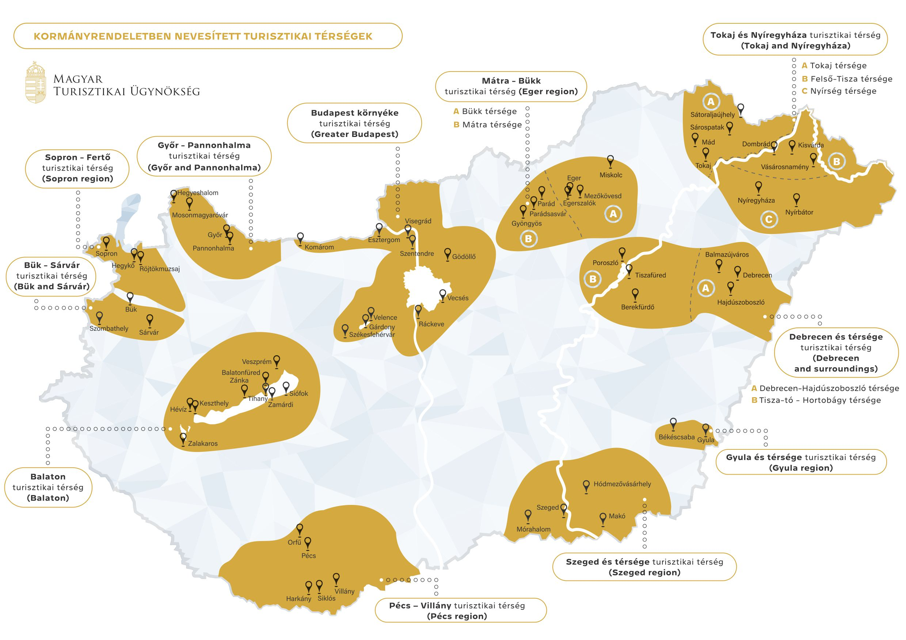
Notes:
A gyakorlatban a működőképes turisztikai desztinációt az alábbiak jellemzik:
megfelelő vonzerőt jelent a turisták számára,
a turisták alapvető szükségleteit ki tudja elégíteni (szállás, étkezés),
a turisták tartózkodási idejük alatt be tudják járni,
képes komplex turisztikai termék fejlesztésére és a hálózatba szervezett kínálatát azonos márka alatt piacra vinni,
fejlődés és fejlesztés szempontjából egy egységet alkot,
adottak a feltételek a terület stratégiai menedzselésére,
a térség érintettjei és érdekeltjei hajlandóak az együttműködésre. (Holczerné, 2015)

Slide 8
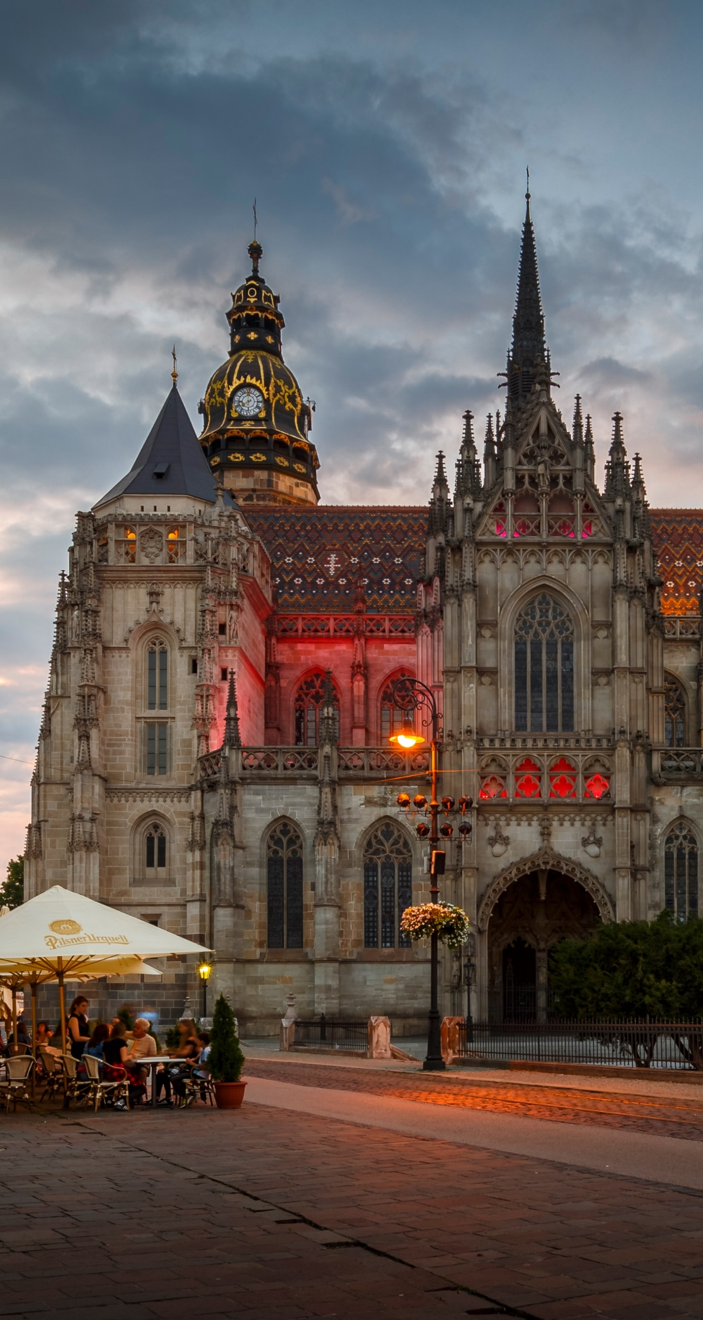
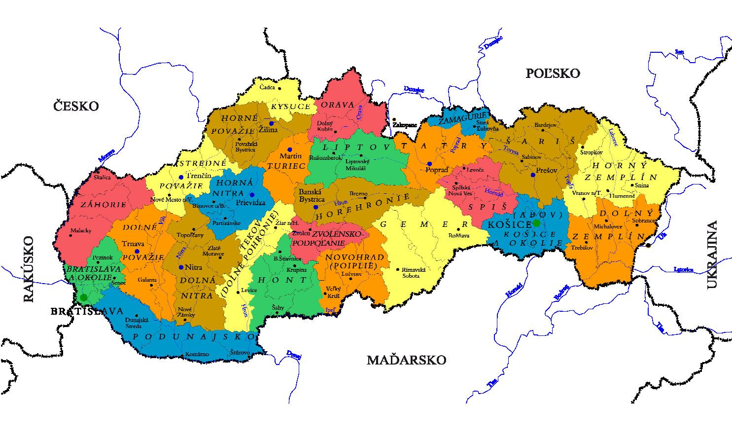
Notes:
„Minden desztináció menedzsment szervezet közös célja, hogy maximalizálja a látogató számára a minőség és az érték érzetét úgy, hogy a hosszútávú fenntarthatóság és a versenyképesség érdekében megvédi a desztináció természeti és kulturális értékeit és elősegíti a helyi gazdaság és a lakosság jól-létét.” (UNWTO, 2019)

Slide 9

Tourism attraction
Tourist attraction is a place of interest that tourists visit, typically for its inherent or an exhibited natural or cultural value, historical significance, natural or built beauty, offering leisure and amusement.
Tourist attraction is a place that attracts is visited regularly or at least seasonally and generates a critical mass of financial expenditures or can attract visitors after the development activities are carried out.
Notes:
A turisztikai attrakció olyan látnivaló, amelyet a turisták jellemzően benne rejlő vagy kiállított természeti vagy kulturális értéke, történelmi jelentősége, természeti vagy épített szépsége miatt keresnek fel, amely szabadidős és szórakozási lehetőséget kínál.
A turisztikai attrakció olyan hely, amely rendszeresen vagy legalább szezonálisan látogatott, és amely kritikus tömegű pénzügyi kiadásokat generál, vagy a fejlesztési tevékenységek elvégzése után vonzza a látogatókat.

Slide 10

Market-based services
Under the present Call, market-based services are complex range of products and services (e.g. accommodation, catering, transport, programmes) to meet the needs of visitors. These products and services can be sold on a market basis, ensuring the economic sustainability of the destination's tourism sector.
Notes:
A jelen Felhívás értelmében a piaci alapú szolgáltatások olyan komplex termékek és szolgáltatások (pl. szállás, étkeztetés, szállítás, programok) a látogatók igényeit kielégítik. Ezek a termékek és szolgáltatások piaci alapon értékesíthetők, biztosítva a desztináció turisztikai szektorának gazdasági fenntarthatóságát.

Slide 11

Territorial action plan
Action 2.4.2 aims is implemented through integrated development actions. These actions are based on a joint territorial action plan comprising several cross-border projects tailored to the region-specific natural and cultural values of the different target areas, the motivations and complex needs of potential tourists and their communication and media consumption habits.
Notes:
A területi akcióterv integrált fejlesztési beavatkozások összessége.
Ezek beavatkozások alapja egy közös területi akcióterv
Az akcióterv olyan projekteket tartalmaz amelyek
egy adott térség regióspecifikus természeti és kulturális értekeihez,
a látogatók komplex igényeihez,
és a látogatók kommunikációs és medifogyasztási igenyeihez
Igazítva jöttek létre.

Slide 12

Territorial action plan document
The document provides a solid basis for the cross-border integrated approach. The action plan must define the main assets of a selected territory, its strengths and weaknesses, its advantages and disadvantages compared to their regional competitors and define the tourism sectors to be specifically developed within the framework of the TAP. The elaboration of the territorial action plan begins with the delineation of the target area.
Notes:
A dokumentum szilárd alapot biztosít a határokon átnyúló integrált megközelítéshez.
A cselekvési tervnek meg kell határoznia a kiválasztott terület fő értékeit,
erősségeit, és gyengeségeit,
előnyeit és hátrányait a regionális versenytársakkal szemben, és meg kell határoznia
a TAP keretében kifejezetten fejlesztendő idegenforgalmi ágazatokat.
A területi cselekvési terv kidolgozása a célterület lehatárolásával kezdődik.

Slide 13
Target area
cross-border
strive for geographical and/or ethnographic homogeneity
compact and continuous area with a strong internal cohesion
considering:
  the natural geography of the area,
  the most common entry and exit points of the area,
  number and location of border crossing points,
  most visited main and complementary attractions nearby,
  usual travelling patterns of visitors during their stay,
  most important unutilised natural or cultural assets nearby.

Slide 14

Consortium
broad collaboration local of representatives and decision-makers from public, non-profit and private organisations that have a strong influence on the tourism industry
is led by coordinating organisations that have a territorial development or destination management agenda
coordinating organisations must reach out to local stakeholders on both sides of the border and ensure the participation of potential applicants in the consortium
the maximum number of organisations participating in the TAP is not limited

Slide 15
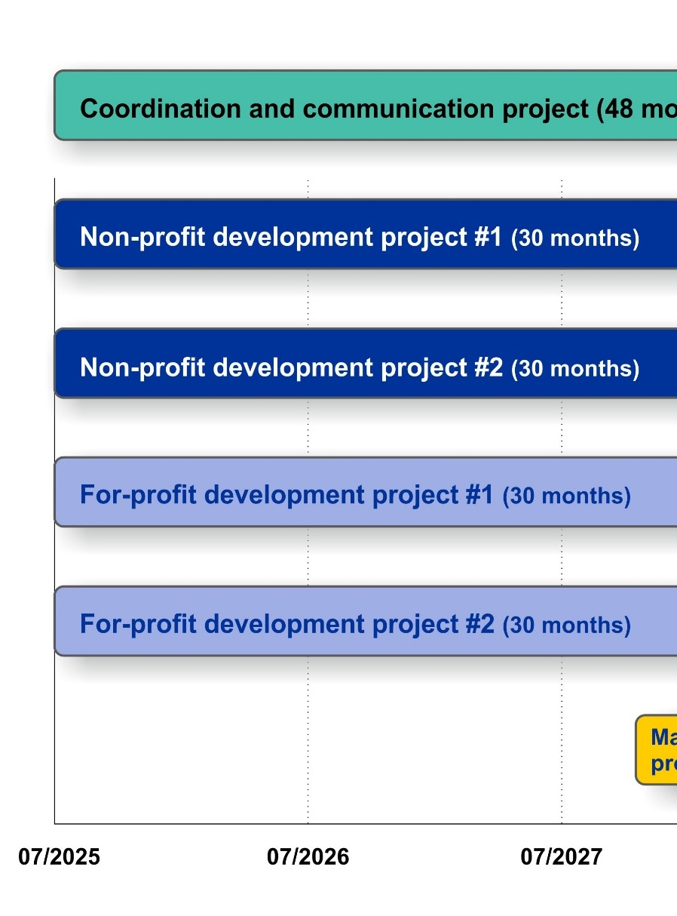
Project development
Each Territorial action plan must contain a minimum of 3 and a maximum of 8 project proposals.
Members of the consortium may participate in more projects.
The project proposals can be divided into four categories depending on the nature of its’ core activities.

Slide 16
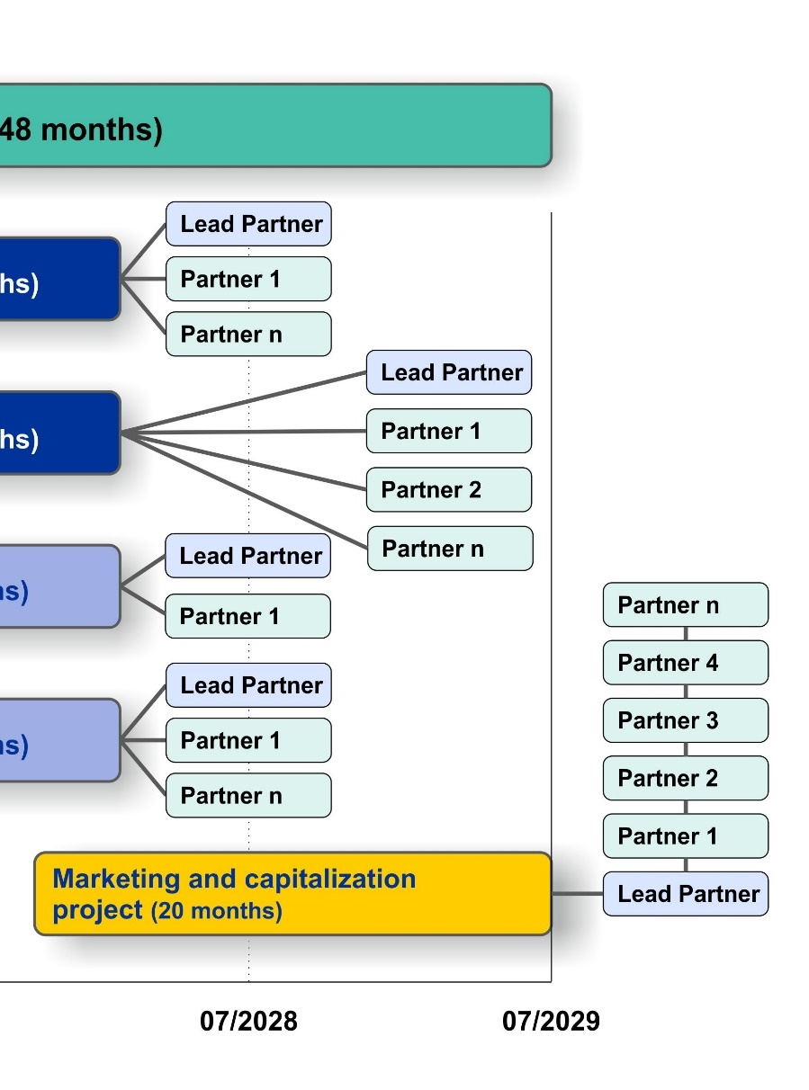
Coordination and communication project (CCP)
The CCP partners are responsible for the coordination, management of the entire action plan. Activities:
the coordination of the TAP consortium,
the preparation of partner and project reports for each partner
CCP can also take over the tasks of visibility and communication for the beneficiaries.

Slide 17
Non-profit development projects (NDP)
renovation, reconstruction, and enhancement of cultural, historical and religious sites to ensure their sustainable use for tourism or the accessibility for the visitors,
restoration and development of natural landscapes and trails to ensure their environ-mentally friendly use for tourism or the accessibility for the visitors, and

Slide 18
Non-profit development projects (NDP)
improving the infrastructural background and accessibility of existing tourism destinations (e.g. car parks, cycle paths, walkways, roads etc.),
experience-focused attraction development by creation or development of services.

Slide 19
For-profit development projects (FDP)
development of existing tourism attractions to ensure their sustainable and efficient utilisation and
development of new or existing market-based tourism services.

Slide 20
Marketing and capitalization project (MCP)
joint marketing and capitalization (e.g. branding, promoting etc.) of tourism destination or attractions,
development of thematic routes and joint tourism packages,
harmonisation of different tourism offers across the border,
training of shortage occupations for the tourism industry and tourism professionals.

Slide 21
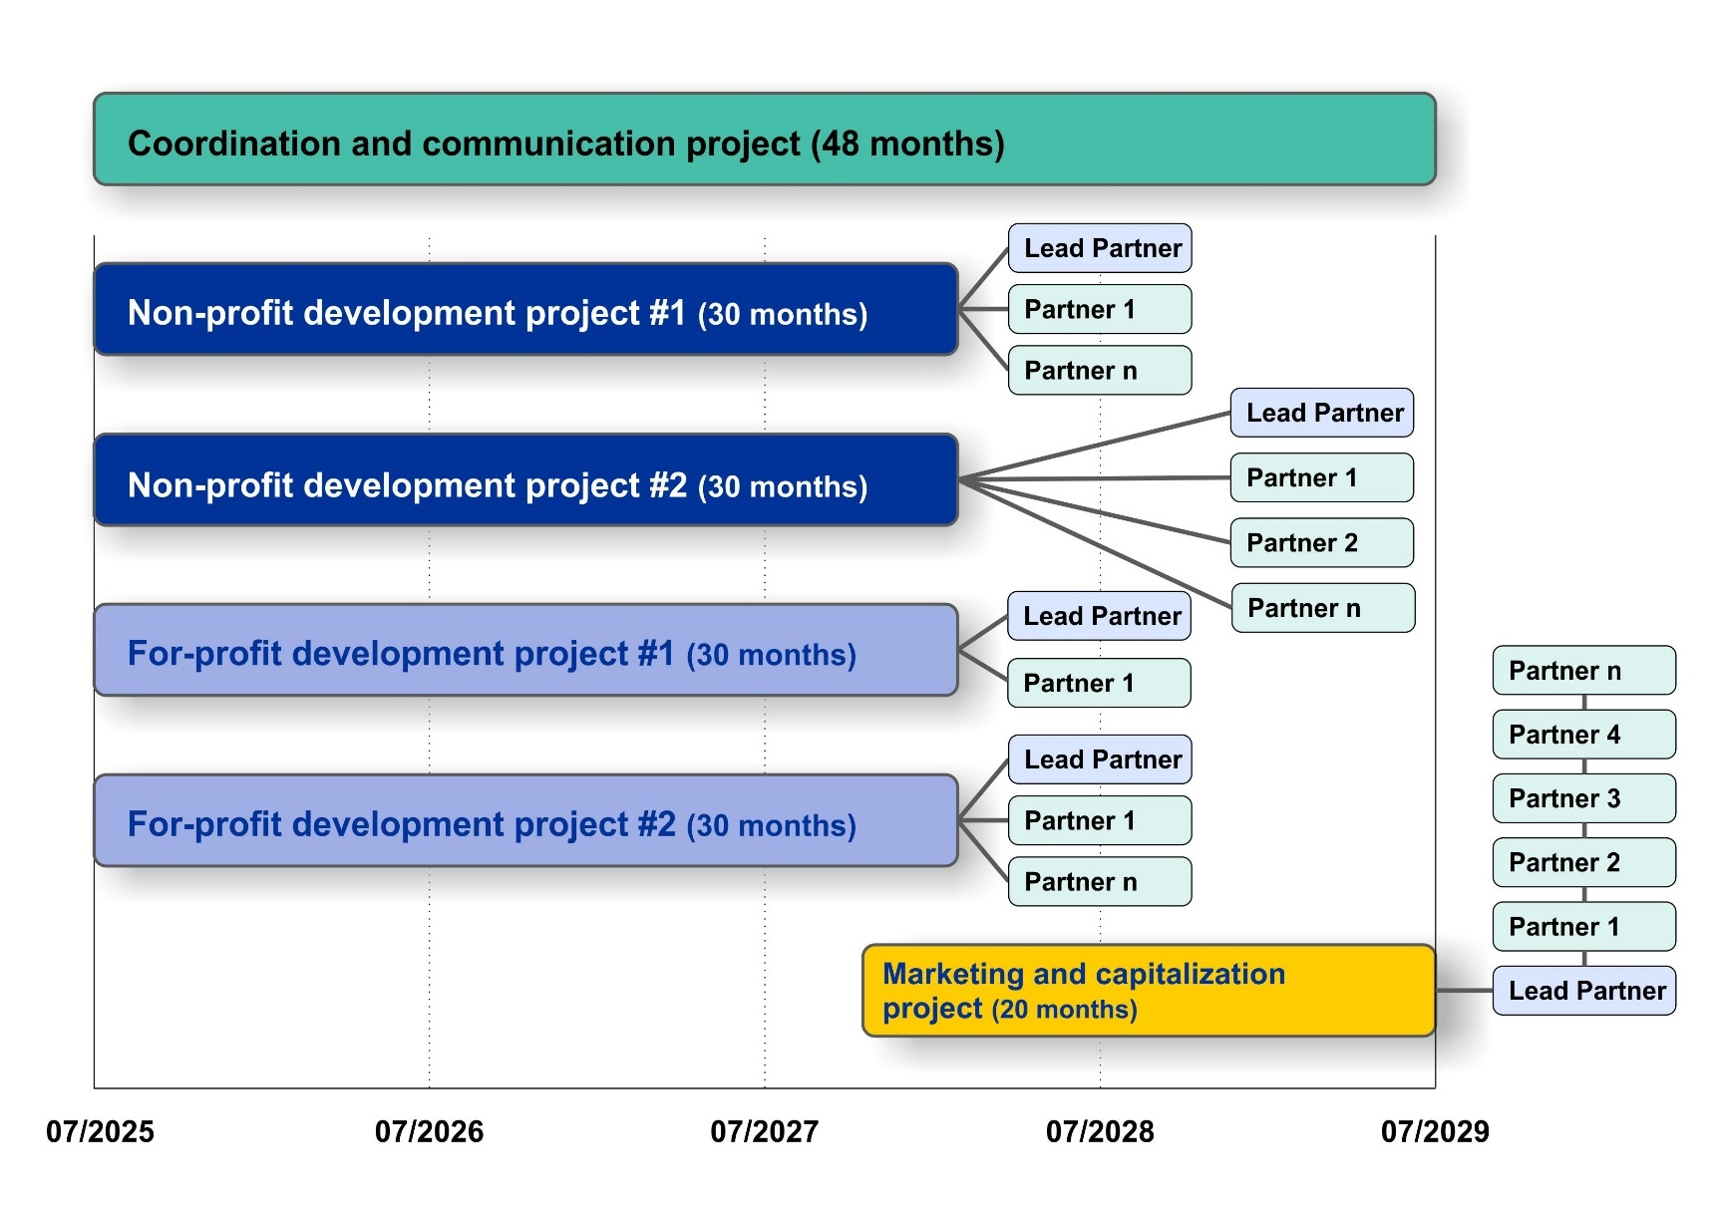

Slide 22
Specific terms
Partners or projects that do not contribute to the complex development of a tourism destination or to the cohesion of the target area can be removed from the action plan during the evaluation process.
Action plans must contain one CCP and one MCP project. The number of NDP or FDP projects is limited only by the maximum number of projects within the TAP.
Marketing and capitalization measures must primarily focus on Hungarian and Slovak visitors and must be prepared minimally in Hungarian and Slovak language.

Slide 23
Main evaluation aspects
The joint action plan should focus on innovative, experience-oriented development that mitigates seasonal fluctuations and extends the season, to which relevant complex service development and cross-sectoral networking should be linked.
In developing the action plan, applicants should endeavour to take a territorial approach, i.e. ensure that the action plan rather supports series of small-scale investments that meet the diverse needs of visitors than a few bigger investments in a single municipality.

Slide 24
Main evaluation aspects
The action plan must aim to increase the attraction potential of the developed sites primarily on the other side of the border through bilingual information boards, cross-border marketing activities and cross-border visitor management.
For-profit developments must have a functioning business model and must have financial and human guarantees for the durability of the project results.

Slide 25

Eligible applicants
Eligible coordinating organisations are the following:
European Groupings of Territorial Cooperation,
Regional Governments at NUTS(III) level,
Territorial Development Agencies,
Destination management organisations.

Slide 26

Eligible applicants
European Groupings of Territorial Cooperation,
local and regional governments and their non-profit or economic organisations,
Development agencies,
Destination management organisations,
National Park directorates,
Nature Park organisations,
Museums and cultural institutions,
Churches,
Nature and environment protection organisations,
Non-governmental organisations,
Small and medium sized enterprises.

Slide 27
Location criteria
Hungary
Győr-Moson-Sopron vármegye
Komárom-Esztergom vármegye
Pest vármegye
Budapest
Nógrád vármegye
Heves vármegye
Borsod-Abaúj-Zemplén vármegye
Szabolcs-Szatmár-Bereg vármegye
Slovak republic
Bratislavský samosprávny kraj
Trnavský samosprávny kraj
Nitriansky samosprávny kraj
Banskobystrický samosprávny kraj
Košický samosprávny kraj

Slide 28
SME criteria
An enterprise is considered to be any entity engaged in an economic activity, irrespective of its legal form. This includes, in particular, self-employed persons and family businesses engaged in craft or other activities, and partnerships or associations regularly engaged in an economic activity.
In the present Call private entrepreneurs and limited liability companies with double-entry bookkeeping are eligible.
Enterprises must have the last two fiscal years closed.
Enterprises cannot have their own equity lower than the half of the prescribed capital stock in the last fiscal year.
The total eligible costs of small and medium-sized enterprises may not exceed twice their turnover in the annual accounts for the full financial year preceding the submission of the application or, in the case of sole proprietors, twice their tax base.

Slide 29

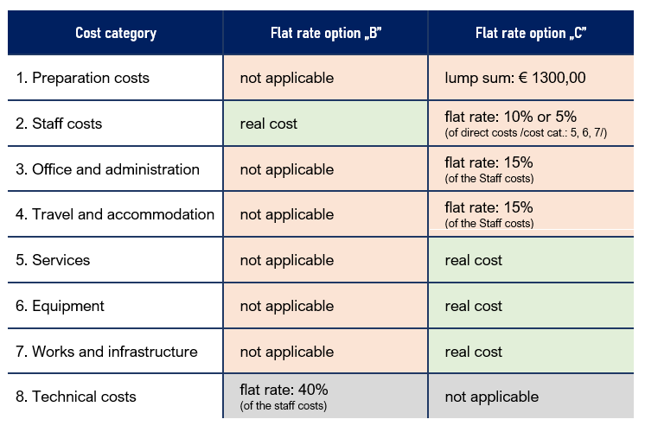
Eligible expenditures

Slide 30
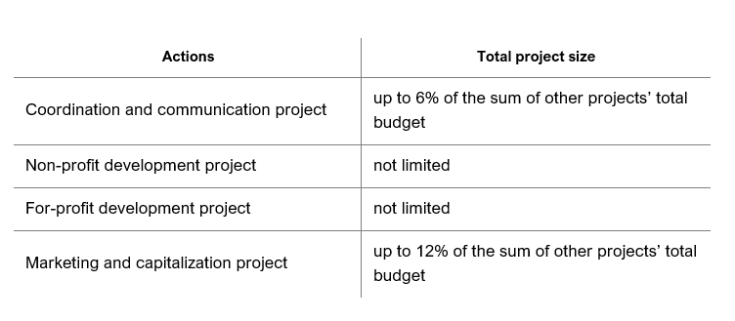
Project size
The indicative ERDF budget of the TAPs is 4.000.000,00 EUR.

Slide 31
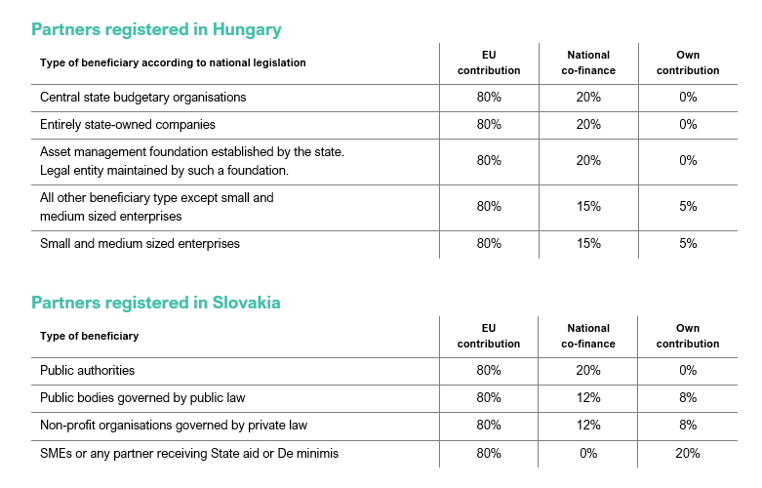
Source of finance

Slide 32
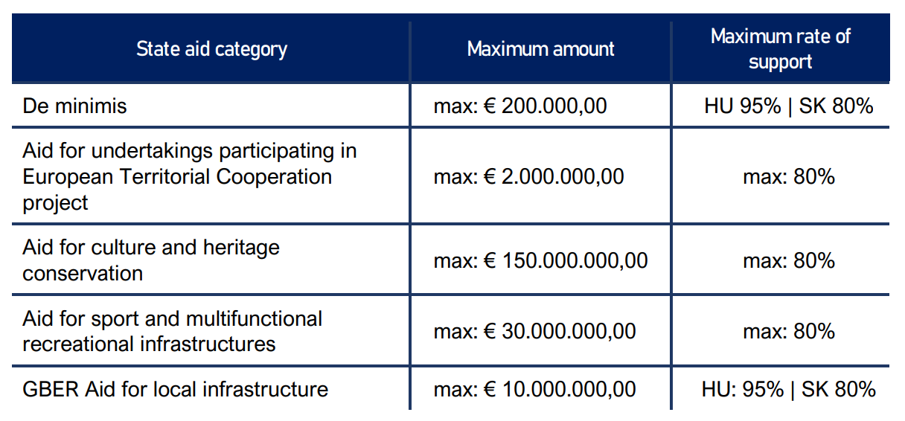
State aid

Slide 33
Mandatory annexes
Coordination and communication project
Mandatory annexes for the CPP projects are the following:
ANNEX I – Partners’ declaration of honour (HU or SK or EN)
ANNEX II – Territorial action plan (HU and SK)
ANNEX III – Map of the target area (EN)
ANNEX VII – CV of the key expert(s) (EN)
ANNEX VIII – De minimis declaration (HU or SK)
Non-profit development projects
Mandatory annexes for the NDP projects are the following:
ANNEX I – Partners’ declaration of honour (HU or SK or EN)
ANNEX IV – Project part concept (HU and SK)
ANNEX VI – Simplified technical documentation (HU or SK)
ANNEX VII – CV of the key expert(s) (EN)
ANNEX VIII – De minimis declaration (HU or SK)

Slide 34
Mandatory annexes
For-profit development projects
Mandatory annexes for the FDP projects are the following:
ANNEX I – Partners’ declaration of honour (HU or SK or EN)
ANNEX V – Business plan (HU and SK)
ANNEX VI – Simplified technical documentation (HU or SK)
ANNEX VIII – De minimis declaration (HU or SK)
ANNEX IX – Test of undertaking in difficulty (HU or SK)
ANNEX X – Financial reports (HU or SK)
Marketing and capitalization project
Mandatory annexes for the FDP projects are the following:
ANNEX I – Partners’ declaration of honour (HU or SK or EN)
ANNEX IV – Project part concept (HU and SK)
ANNEX VI – CV of the key expert (EN)
ANNEX VII – De minimis declaration (HU or SK)

Slide 35
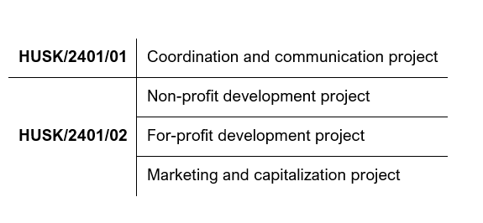
Submission
The Call is divided into two parts with different identification numbers. Lead applicants must submit their project proposals as follows:

Slide 36
Submission
Online Application form must be filled in in English
Call open date: 20/06/2024
Call end date: 20/12/2024 | 15:00
ERDF allocation: 32,710,280 EUR
Est. number of awarded TAPs: 8-10 pcs

Slide 37
Assessment
As a first step, the quality assessment of the CCP projects submitted for part HUSK/2401/01 is carried out.
The CCP projects will be evaluated against the criteria listed in the quality assessment grids published as part of the Call for proposals defined for the HUSK/2401/01 part.
The total score can be between 0 and 100.
The assessment is divided into three parts:
a) strategic assessment (35 points),
b) territorial assessment (15 points),
c) sectoral assessment (50 points).

Slide 38
Assessment
The final score is the sum of the average scores from each part of the quality assessment.
If the submitted application does not reach the 60% of the maximum score in the strategic and territorial assessment, the application will not be forwarded to the sectoral assessment.
If the submitted application does not reach 65% of the maximum score in the quality assessment, the project will be rejected without consideration.
CCP projects grouped into the following categories:
  projects proposed for approval,
  projects proposed for approval with condition,
  projects proposed to be put on the reserve list,
  project proposed to be rejected due to insufficient funds,
  projects proposed to be rejected due to not reaching the minimum threshold of scores.

Slide 39
Assessment
In the second-round sectoral assessors evaluate only projects submitted for part HUSK/2401/02
that were associated with the CCP projects proposed for approval, approval with conditions or put on the reserve list.
The projects will be evaluated against the criteria listed in the quality assessment grids published as part of the Call for proposals
The sectoral assessors evaluate the fulfilment of each criterion on a qualitative basis, providing textual justifications.

Slide 40
Assessment
Projects will be classified into the following categories:
projects proposed for approval,
projects proposed for approval with condition,
projects proposed for re-submission,
projects proposed to be rejected due to qualitative reasons.

Slide 41
Technical support
Silvester Holop
szholop@skhu.eu
+36 30 835 8546
Interreg+ helpdesk
iplussupport@szpi.hu

Slide 42
Thank you for your attention!
Silvester Holop
Deputy Head of the Joint Secretariat
szholop@skhu.eu
+36 30 835 8546

